Slide 1
Secure Hash Algorithm (SHA-1)
SHA was designed by NIST & NSA in 1993, revised 1995 as SHA-1
produces 160-bit hash values
generally preferred hash algorithm
based on design of MD5
Message Size < 2⁶⁴
Input: block of message: 512 bits
Output : 160 bits- message digest
Notes:
SHA is one of the newer generation of hash functions, more resistant to cryptanalysis, and now probably preferred for new applications.

Slide 2
SHA – 1 Logic
1.Append padding bits 10…0 (1 to 512 bits)
2.Append length of original message
3. Initialise Message Digest Buffer: A B C D E (like in MD5)
4. Process message in blocks
5. Output hash value

Slide 3
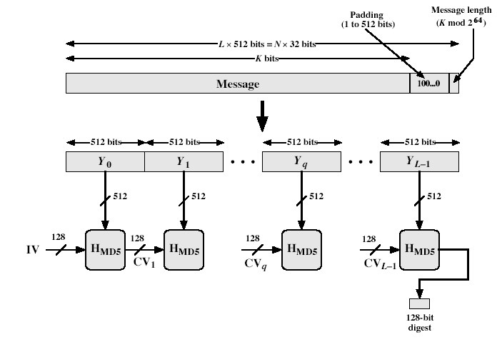
MD5 structure

Slide 4
SHA Overview
pad message so that its length is congruent to 448 mod 512
append a 64-bit length value to message
initialise 5-word (160-bit) buffer (A,B,C,D,E) to
(67452301,efcdab89,98badcfe,10325476,c3d2e1f0)
process message in 16-word (512-bit) chunks:
expand 16 words into 80 words by mixing & shifting
use 4 rounds of 20 steps of bit operations on message block & buffer
add output to input to form new buffer value
output hash value is the final buffer value
Notes:
Note that the SHA-1 Overview is very similar to that of MD5.

Slide 5
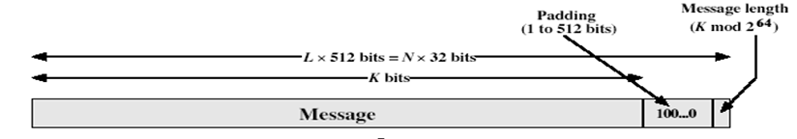
SHA 1 Algorithm
Append Padding bits. Pad message so that its length is congruent to 448 mod 512.
(i.e., length of the message is = n*512+448).
Padding bits are 100...0
Number of bits padded will be 1 to 512
Padding is mandatory even if the message is having desired length already
Append length of original message in 64 bits format. Note length of original message < 2 ^64 bits.
Notes:
The padded message is broken into 512-bit blocks, processed along with the buffer value using 4 rounds, and the result added to the input buffer to make the new buffer value. Repeat till run out of message, and use final buffer value as hash. nb. due to padding always have a full final block (with length in it).

Slide 6
3. Initialise MD buffer. Five ‘32’ bit registers (A,B,C,D, E) are used to store 128-bits buffer data. Initialise registers as:
A=67452301
B=EFCDAB89
C=98BADCFE
D=10325476
E= C3D2E1F0

Slide 7
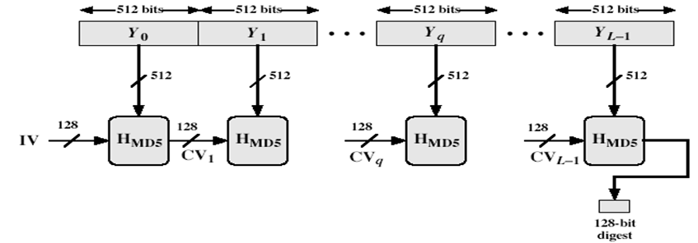
4. Process message in 512-bit blocks:
Divide message into blocks of size 512 bits.
Apply Compression function ( round function) on each block.
If Z is the buffer value before applying function and Z’ is the buffer value after applying function, then update buffer as Z+Z’
5. Output. After processing all blocks, output of final block is the message digest of size 160 bits.

Slide 8
Compression function (H_{MD5})
Input : message block (512 bits) and buffer data (160 bits)
Output: 160 bits (updated value in buffer)
The compression function has 4 rounds.
Each round uses one of the logical function f1, f2, f3, f4 and a constant K

Slide 9
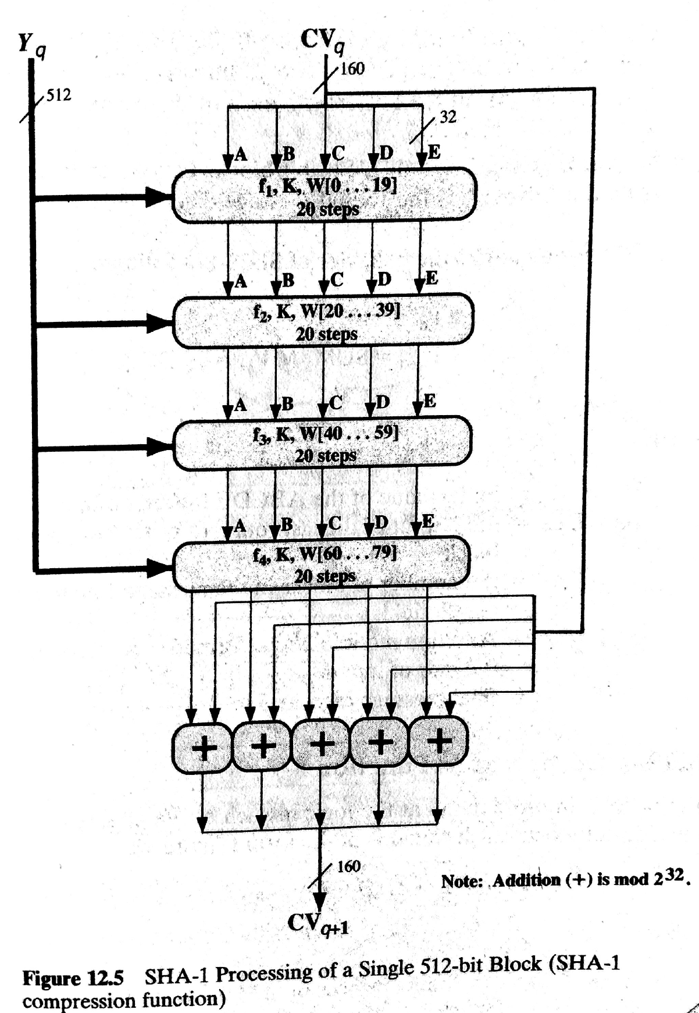

Slide 10
Each round has 20 steps.
Following operations are performed in each step:
(A,B,C,D,E) <-(E+f(t,B,C,D)+(A<<5)+W_{t}+K_{t}),A,(B<<30),C,D)
A,B,C,D,E are the words (registers) of the buffer
t is the step number
f(t,B,C,D) is nonlinear logical function for round
W_{t} is derived from the message block
K_{t} is a constant value
Notes:
Can see SHA shares much in common with MD4/5, but with 20 instead of 16 steps in each of the 4 rounds. Note the 4 constants are based on sqrt(2,3,5,10). Note also that instead of just splitting the input block into 32-bit words and using them directly, SHA-1 shuffles and mixes them using rotates & XOR’s to form a more complex input, and greatly increases the difficulty of finding collisions.

Slide 11
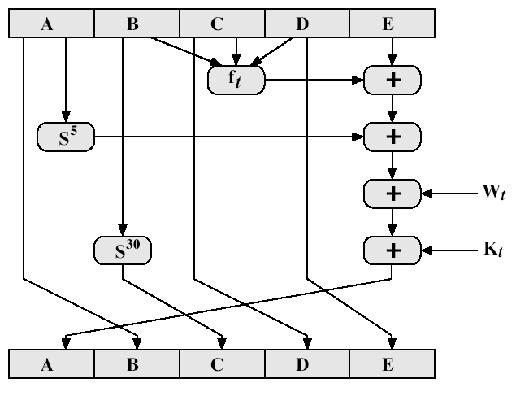
SHA-1 Compression Function

Slide 12
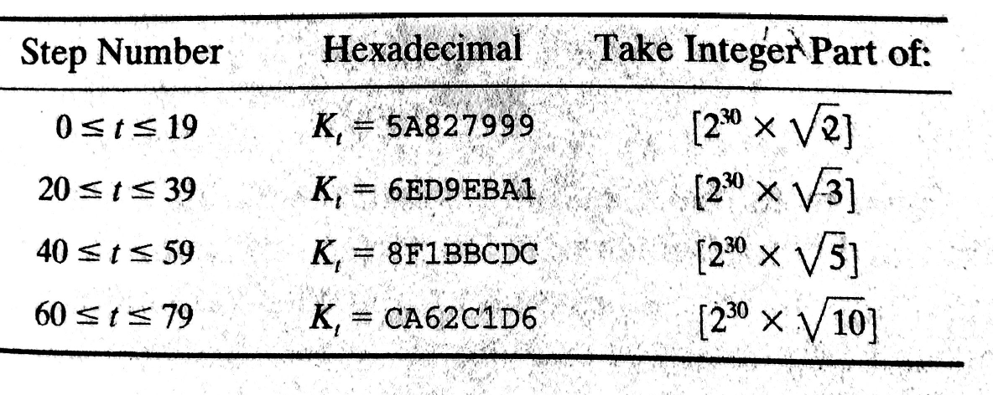
Constant K used in rounds

Slide 13
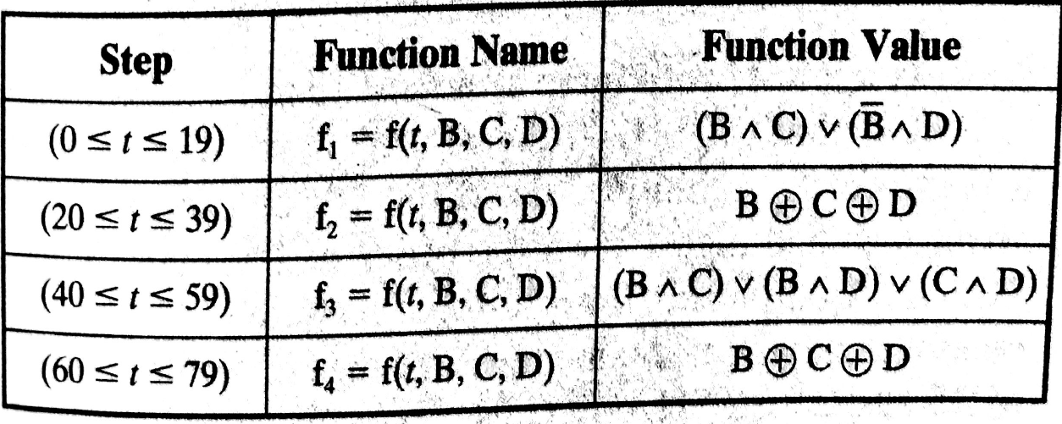
Logical functions f used in rounds

Slide 14
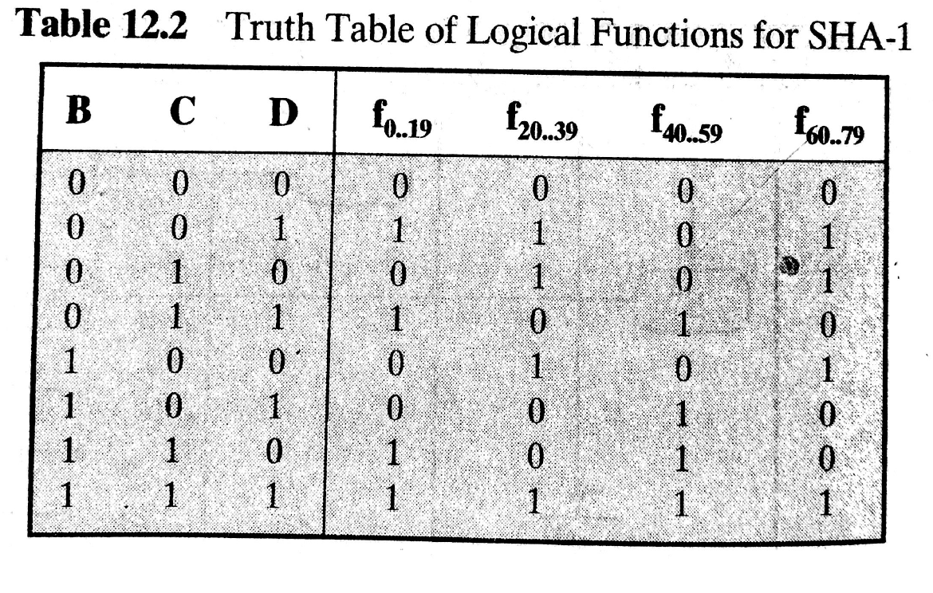

Slide 15
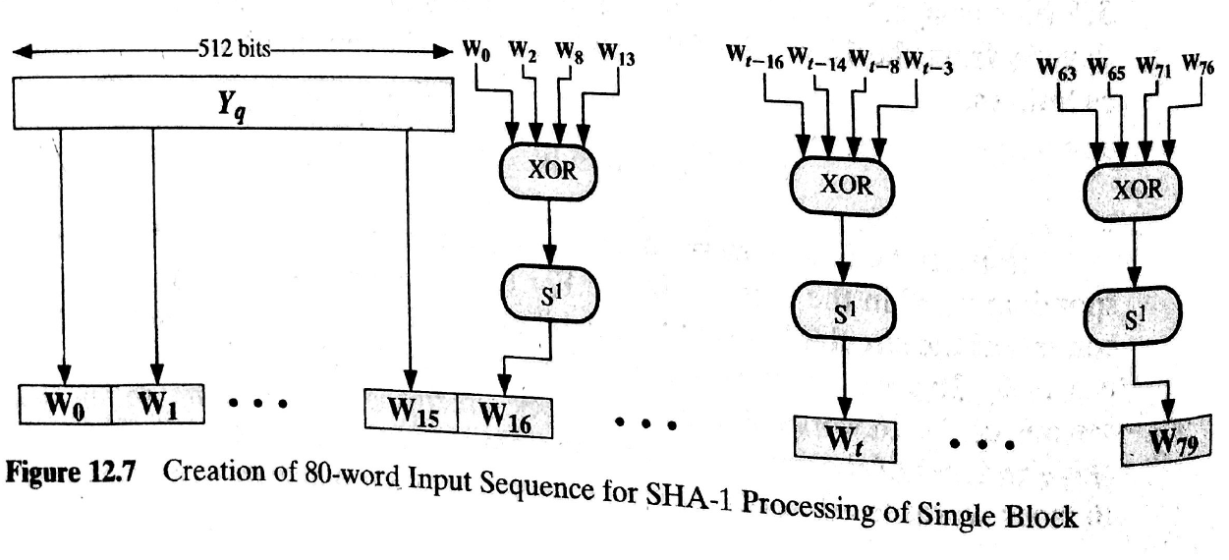

Slide 16
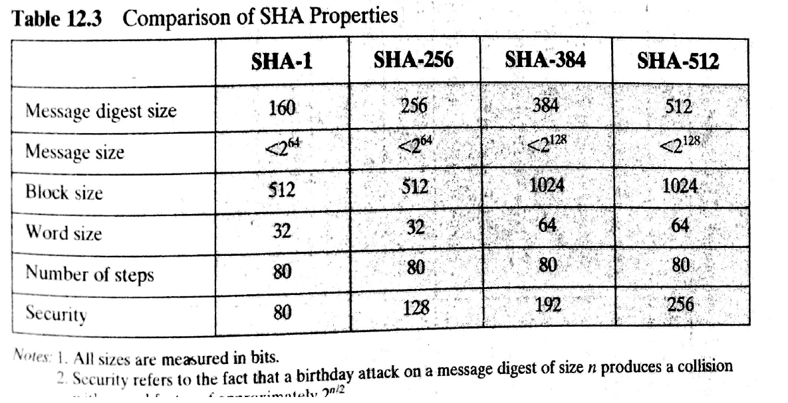

Slide 17
SHA-1 verses MD5
brute force attack is harder (160 vs 128 bits for MD5)
not vulnerable to any known attacks (compared to MD4/5)
a little slower than MD5 (80 vs 64 steps)
both designed as simple and compact
optimised for big endian CPU's (vs MD5 which is optimised for little endian CPU’s)
Notes:
Compare using the design goals listed earlier.
SHA-1 is probbaly the preferred hash function for new applications. Currently no problems are known with it.

